Slide 1
Laravel Http Client
What is http client ?
What is laravel http client?

Slide 2
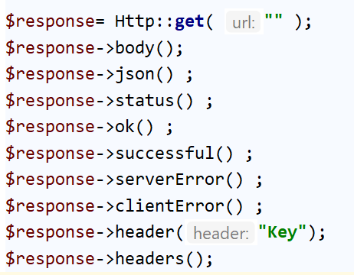
Laravel Http Client
Simple get request
use Illuminate\Support\Facades\Http;

Slide 3
Laravel Http Client
Simple Post
use Illuminate\Support\Facades\Http;

Slide 4
Laravel Http Client
JSON Response
POST / GET

